Slide 1


Experimental investigation of mechanical properties of composite/plastic metals produced by 3d printing
PROJECT TITLE
Mechanical
Department
Batch - 19CD005
190070042 | K.Rajesh
190070140 | Ravi Prabhat
190079002 | S.Y.Kalyan Reddy
190079010 | T M V P S Teja Naidu
Project Guide: Dr. K. V. Durga Rajesh

Slide 2
There Are Several Types Of 3D Printing, Which Include:
Stereolithography (SLA)
Selective Laser Sintering (SLS)
Fused Deposition Modeling (FDM)
Digital Light Process (DLP)
Multi Jet Fusion (MJF)
Direct Metal Laser Sintering (DMLS)
Electron Beam Melting (EBM)

Slide 3
Introduction:
AION-500 3-D Printing:
India’s first industrial grade professional 3D printer with patented Advanced Fusion Plastic Modelling (AFPM) technology.
The revolutionary AION 500 is a high performance, massive size 3D printer that offers a professional-level build volume at an affordable price point. Armed with our patented AFPM (Advanced Fusion Plastic Modelling) technology.
AION 500 is a fully enclosed industrial grade 3D printer and assures a consistently high print quality and repeatability.
. The machine is easy to use allowing the user to alternate between quick-&- easy to professional-grade printing smoothly.

Slide 4
Plastic Materials:
Acrylonitrile butadiene styrene (ABS):
ABS provides favorable mechanical properties such as impact resistance, toughness, and rigidity when compared with other common polymers.
ABS has a strong resistance to corrosive chemicals and/or physical impacts.
It is very easy to machine and has a low melting temperature making it particularly simple to use in injection molding manufacturing processes or 3D printing on an FDM (Fused Deposition Modeling ) machine.
ABS is also relatively inexpensive. ABS plastic is not typically used in high heat situations due to its low melting point.
These characteristics lead to ABS being used in a large number of applications across a wide range of industries.

Slide 5
ABS Material Properties - Food-Grade Plastic - Food Safe
Property | Metric | units | English | units
General
Density | 1.01e3 - 1.21e3 | kg/m^3 | 63.1 - 75.5 | lb/ft^3
Mechanical
Yield Strength | 1.85e7 - 5.1e7 | Pa | 2.68 - 7.4 | ksi
Tensile Strength | 2.76e7 - 5.52e7 | Pa | 4 - 8.01 | ksi
Elongation | 0.015 - 1 | % strain | 1.5 - 100 | % strain
Hardness (Vickers) | 5.49e7 - 1.5e8 | Pa | 5.6 - 15.3 | HV
Fracture Toughness | 1.19e6 - 4.29e6 | Pa/m^0.5 | 1.08 - 3.9 | ksi/in^0.5
Young's Modulus | 1.19e9 - 2.9e9 | Pa | 0.16 - 0.421 | 10^6 psi
Thermal
Max Service Temperature | 61.9 - 76.9 | °C | 143 - 170 | °F
Insulator or Conductor | Insulator |  | Insulator
Specific Heat Capability | 1.39e3 - 1.92e3 | J/kg °C | 0.331 - 0.458 | BTU/lb. °F
Thermal Expansion Coefficient | 8.46e-5 - 2.34e-4 | strain/°C | 47 - 130 | µstrain/°F
Eco
CO2 Footprint | 9.1e7 - 1.02e8 | kg/kg | 3.27 - 3.62 | lb/lb
Recyclable | Yes |  | Yes

Slide 6
Polylactic Acid(PLA):
Polylactic acid, also known as PLA, is a thermoplastic monomer derived from renewable, organic sources such as corn starch or sugar cane. PLA is the second most produced bioplastic and it is biodegradable.
The physical and mechanical properties differ according to the exact type of polymer, ranging from an amorphous glassy polymer to a semi or highly crystalline polymer with a glass transition of 60–65 °C, a melting temperature 130-180 °C, and a tensile modulus of 2.7–16 GPa. Several technologies such as annealing, adding nucleating agents, forming composites with fibers or nano-particles, chain extending and introducing crosslink structures have been used to enhance the mechanical properties of PLA polymers. The high surface energy of PLA makes it ideal for 3D printing.
PLA has a number of common uses, including for medical and food purposes. It is also widely used as a 3D printing feedstock for desktop fused filament fabrication 3D printers. PLA is popular for 3D printing as it can easily be sanded, painted or post processed. A user friendly material, this plastic works with low extrusion temperatures and there is no need for a heated bed, printer chamber or reinforced nozzle. Another benefit is that PLA behaves better than many tougher plastics and also doesn’t release fumes or bad odours. Storage is easy and it can be produced in a variety of colors. PLA, created with injection moulding, casting or by being spun, is also used as a decomposable packaging material, film or for cups and bags. It is used for compost bags, food packaging, disposable tableware, and loose fill packaging.

Slide 7
Material Properties of PLA
Property | Value
Technical Name | Polylactic Acid (PLA)
Chemical Formula | (C3H4O2)n
Melt Temperature | PLLA: 157 - 170 °C (315 - 338 °F)
Typical Injection Molding Temperature | PLLA: 178 - 240 °C (353 - 464 °F)
Heat Deflection Temperature (HDT) | 49 - 52 °C (121 - 126 °F) at 0.46 MPa (66 PSI)
Tensile Strength | PLLA: 61 - 66 MPa (8840 - 9500 PSI)
Flexural Strength | PLLA: 48 - 110 MPa (6,950 - 16,000 PSI)
Specific Gravity | PLLA: 1.24
Shrink Rate | PLLA: 0.37 - 0.41% (0.0037 - 0.0041 in/in)

Slide 8
Polyethylene terephthalate glycol(PETG):
Polyethylene terephthalate glycol, known as PETG or PET-G, is a thermoplastic polyester that delivers significant chemical resistance, durability, and formability for manufacturing.
PETG combines the properties of PET and glycol. This combination means that the overheating issues associated with PET are reduced.
An easily extruded material with good thermal stability, PETG is particularly compatible with food uses.
polyethylene terephthalate glycol is particularly good for 3D printing, having an extrusion temperature of between 220° and 260°C, with a print speed of 40-60mm/s.

Slide 9
Material Properties of PETG
Material Properties of Thermoplastic PETG - Exceptionally Durable
Property |  | Metric | units |  | English | units
General
Density |  | 1.26e3 - 1.28e3 | kg/m^3 |  | 0.0455 - 0.0462 | lb/in^3
Mechanical
Yield Strength |  | 4.79e7 - 5.29e7 | Pa |  | 6.95 - 7.67 | ksi
Tensile Strength |  | 6e7 - 6.6e7 | Pa |  | 8.7 - 9.57 | ksi
Elongation |  | 1.02 - 1.18 | % strain |  | 102 - 118 | % strain
Hardness (Vickers) |  | 1.41e8 - 1.56e8 | Pa |  | 14.4 - 15.9 | HV
Impact Strength (un-notched) |  | 1.9e5 - 2e5 | J/m^2 |  | 90.4 - 95.2 | ft.lbf/in^2
Fracture Toughness |  | 2.11e6 - 2.54e6 | Pa/m^0.5 |  | 1.92 - 2.31 | ksi/in^0.5
Young's Modulus |  | 2.01e9 - 2.11e9 | Pa |  | 0.292 - 0.306 | 10^6 psi
Thermal
Max Service Temperature |  | 51 - 64 | °C |  | 124 - 147 | °F
Melting Temperature |  | 81 - 91 | °C |  | 178 - 196 | °F
Insulator or Conductor |  | Insulator |  |  | Insulator
Specific Heat Capability |  | 1.47e3 - 1.53e3 | J/kg °C |  | 0.352 - 0.366 | BTU/lb. °F
Thermal Expansion Coefficient |  | 1.2e-4 - 1.23e-4 | strain/°C |  | 66.8 - 68.1 | µstrain/°F
Eco
CO2 Footprint |  | 3.22 - 3.56 | kg/kg |  | 3.22 - 3.56 | lb/lb
Recyclable |  | Yes |  |  | Yes

Slide 10
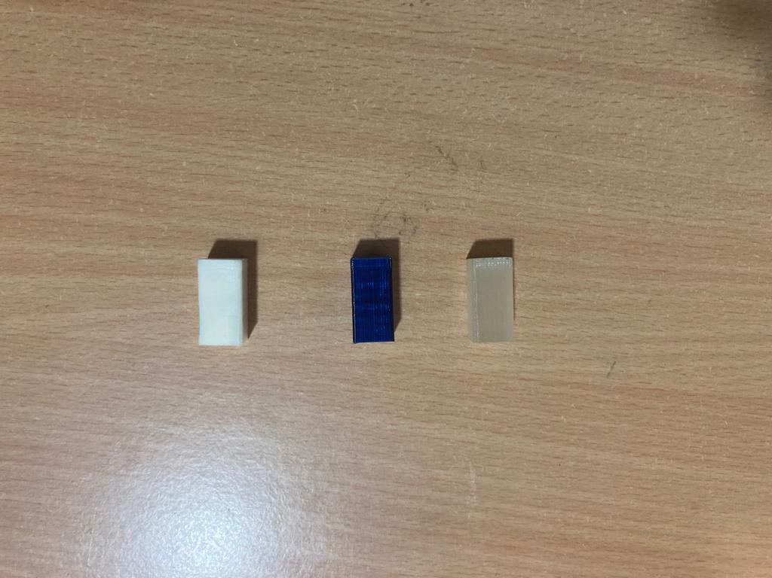
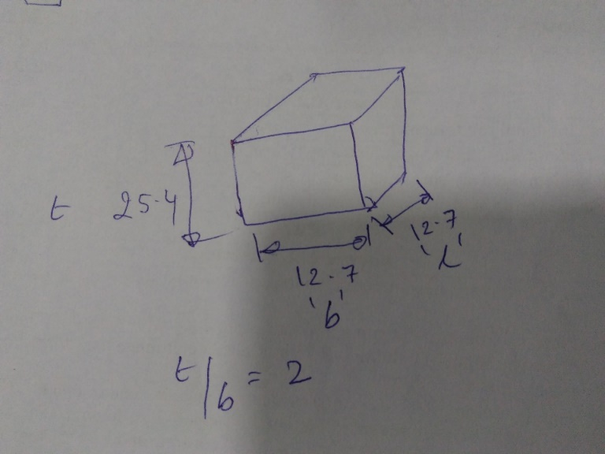
Experimentation Results:

Slide 11
compression test Analysis of ABS material:
Area: | 156.25 | sq-mm
Gauge Length: | 25 | mm
Width: | 12.5 | mm
Thickness: | 12.5 | mm
Peak Stress | 53.806 | MPa
Peak Load | 8.407 | kN
0.2% Offset Yield Stress | 52.745 | MPa
Yield Strain | 4.563 | %
Yield Load | 8.241 | kN
Modulus | 1.182 | GPa
Total Energy | 27.152 | KN-mm
(Input:0.000,0.000) | 0.289 | KN
Energy under selected region
(Input:0.000,0.000) | 0 | kN-mm
Extension at load(input:0.000KN) | 0 | mm
Load at Extension Point
(Input:0.000mm) | 0.289 | KN
Strain Hardening Exponent | 0.007
Strain Hardening Coefficient | 55.395 | Mpa

Slide 12
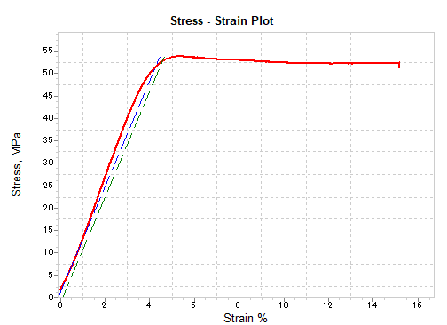
plots of stress –strain & True stress and true strain.

Slide 13
Compression test Analysis of PETG material:
Area: | 156.25 | sq-mm
Gauge Length: | 25 | mm
Width: | 12.5 | mm
Thickness: | 12.5 | mm
Peak Stress | 42.461 | MPa
Peak Load | 6.634 | kN
0.2% Offset Yield Stress | 41.65 | MPa
Yield Strain | 4.618 | %
Yield Load | 6.508 | kN
Modulus | 0.926 | GPa
Total Energy | 15.592 | KN-mm
Average load over extension range
(Input:0.000,0.000) | 0.25 | KN
Energy under selected region
(Input:0.000,0.000) | 0 | kN-mm
Extension at load(input:0.000KN) | 0 | mm
Load at Extension Point
(Input:0.000mm) | 0.251 | KN
Strain Hardening Exponent | 0.009
Strain Hardening Coefficient | 44.214 | Mpa

Slide 14
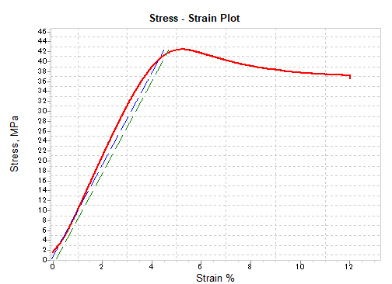
plots of stress –strain & True stress and true strain.

Slide 15
compression test Analysis of PLA material:
Area: | 156.25 | sq-mm
Gauge Length: | 25 | mm
Width: | 12.5 | mm
Thickness: | 12.5 | mm
Peak Stress | 74.247 | MPa
Peak Load | 11.601 | kN
0.2% Offset Yield Stress | 72.6 | MPa
Yield Strain | 6.287 | %
Yield Load | 11.344 | kN
Modulus | 1.319 | GPa
Total Energy | 23.267 | KN-mm
Average Load over extension Range
(Input:0.000,0.000) | 0.176 | KN
Energy under selected region
(Input:0.000,0.000) | 0 | kN-mm
Extension at load(input:0.000KN) | 0 | mm
Load at Extension Point
(Input:0.000mm) | 0.176 | KN
Strain Hardening Exponent | 0
Strain Hardening Coefficient | 0 | Mpa

Slide 16
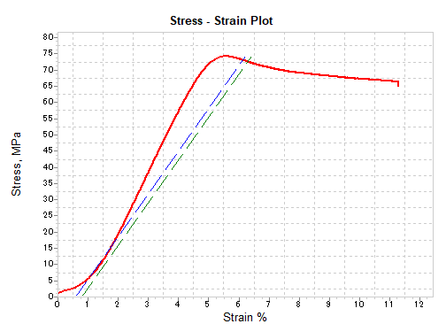
plots of stress –strain & True stress and true strain.

Slide 17
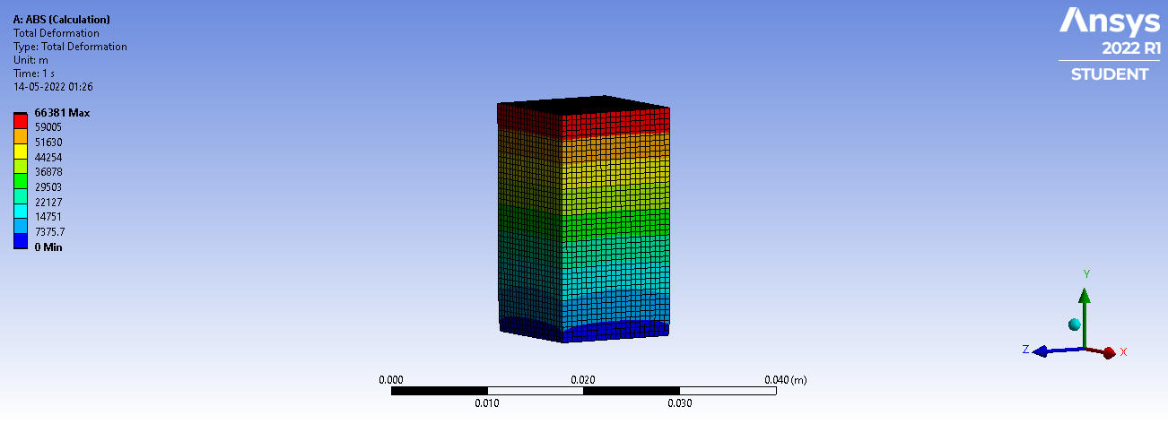
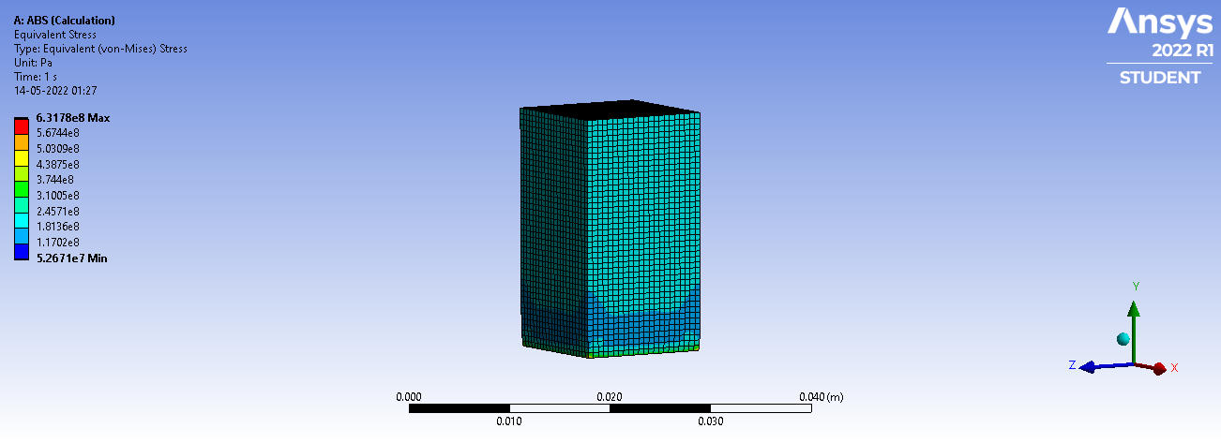
Analysis: Analysis of ABS material:
 | Von misses stress
Youngs modulus | peak load | min | max | Avg
1.182 | 8.4047 KN | 1.36E+07 | 1.63E+08 | 5.07E+07
Total Deformation
peak load | min | max | Avg
8.407 KN | 0 | 1.10E-0.3 | 5.40E-04

Slide 18
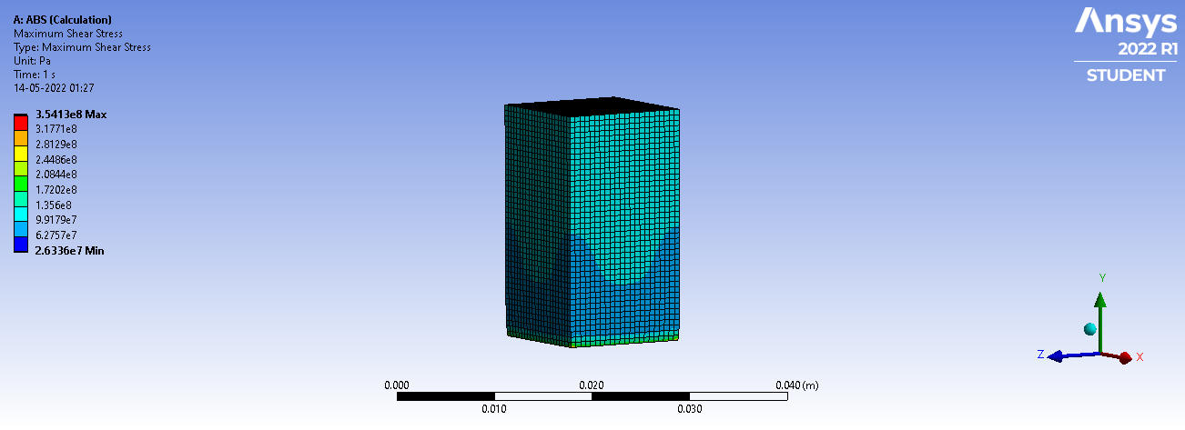
Analysis of ABS material:
 | Max shear stress
peak load |  | min | max |  | Avg
8.4047 KN |  | 6.81E+06 | 9.16E+07 |  | 2.56E+07

Slide 19
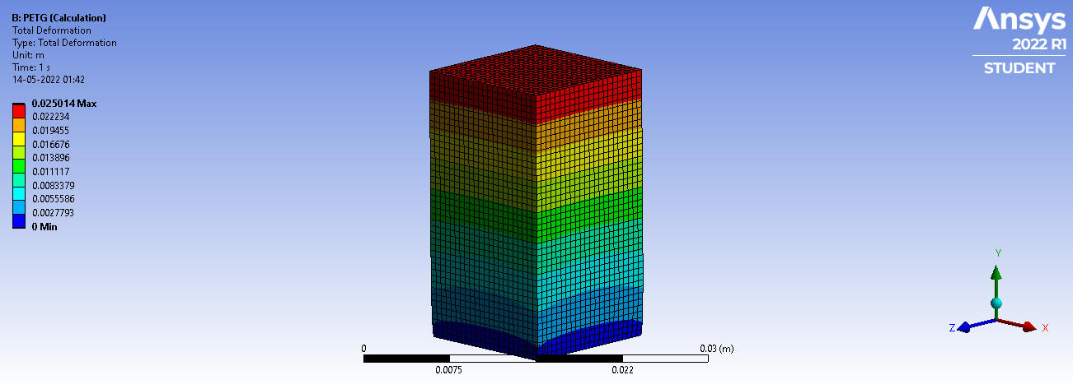
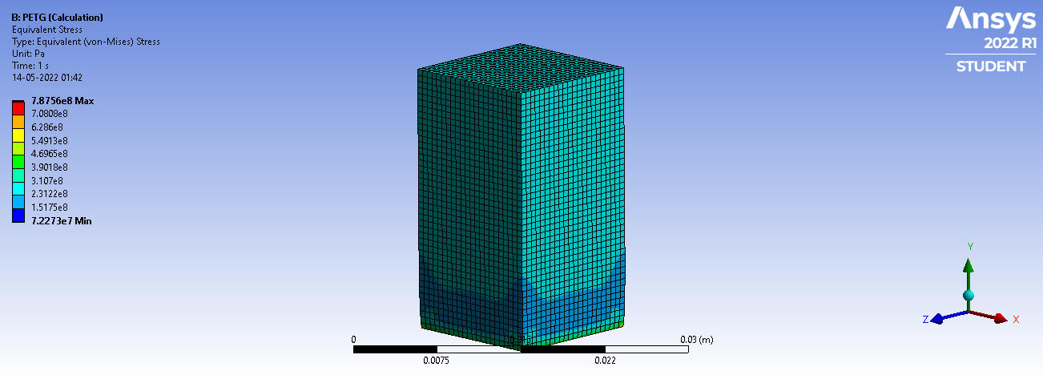
Analysis of PETG material:
Total Deformation
peak load | min | max | Avg
6.634 KN | 0 | 1.11E-0.3 | 5.45E-04
 | Von misses stress
Youngs modulus | peak load | min | max | Avg
0.926 | 6.634 KN | 1.16E+07 | 1.27E+08 | 4.00E+07

Slide 20
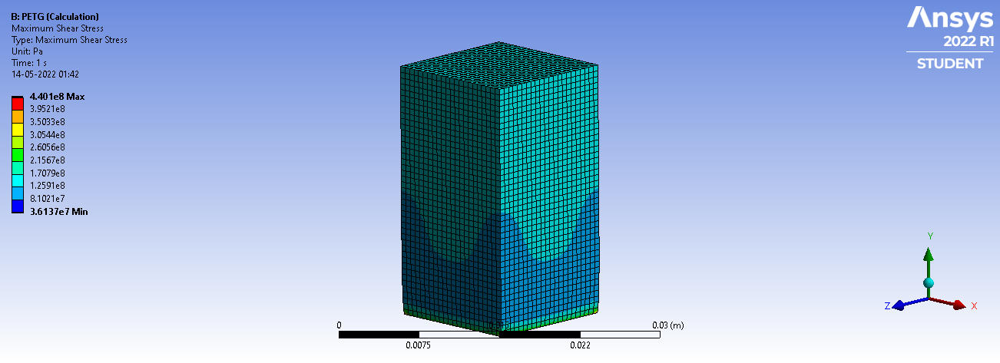
 | Max shear stress
peak load |  | min | max |  | Avg
6.634 KN |  | 5.82E+06 | 7.09E+07 |  | 2.02E+07

Slide 21
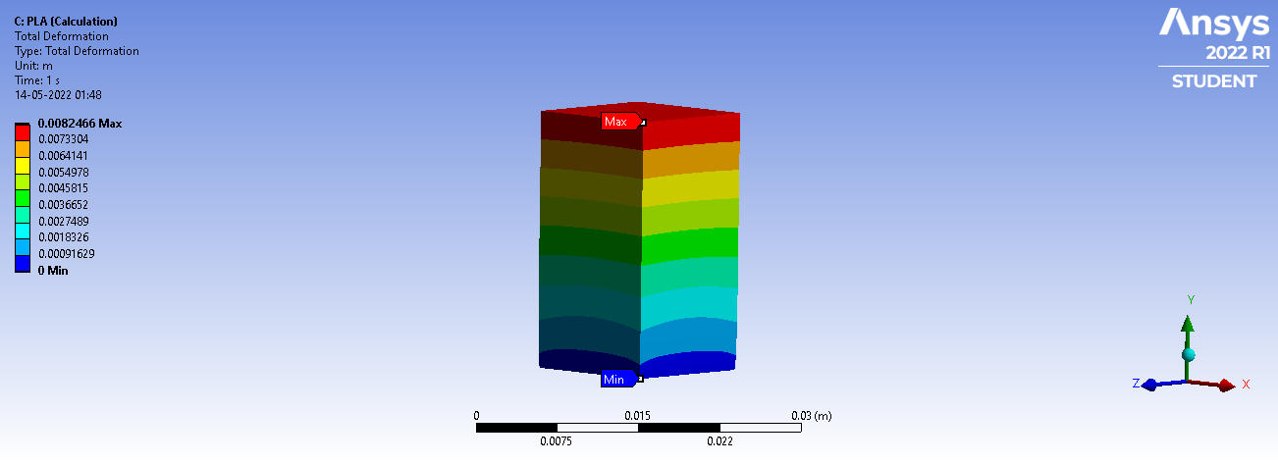
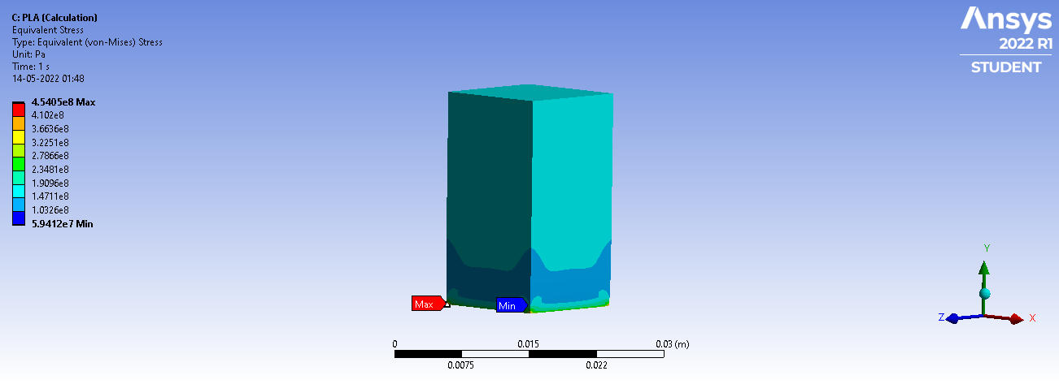
Analysis of PLA material:
Total Deformation
peak load | min | max | Avg
11.601 | 0 | 1.37E-0.3 | 6.744
 | Von misses stress
Youngs modulus | peak load | min | max | Avg
1.319 | 11.601 KN | 2.69EE+07 | 2.06E+08 | 7.01E+07

Slide 22
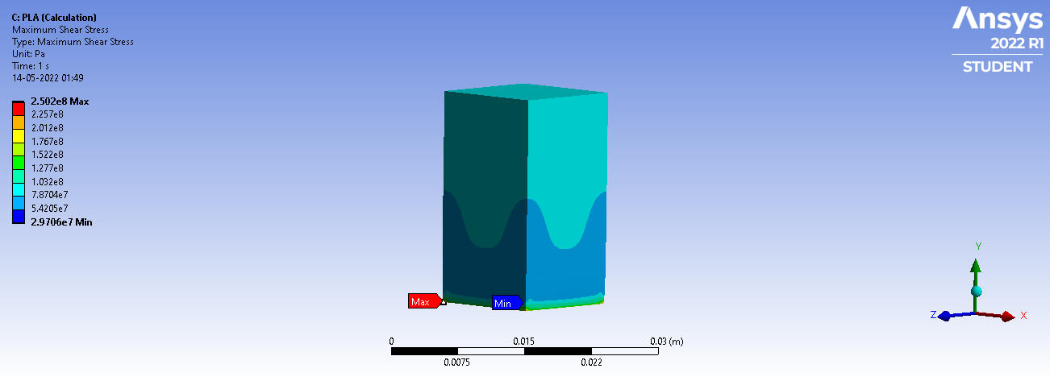
 | Max shear stress
peak load |  | min | max |  | Avg
11.601 KN |  | 1.34E+07 | 1.13E+08 |  | 3.53E+07

Slide 23
Conclusion
From the Experimental investigation of mechanical properties of composite/plastic metals produced by 3d printing materials like PLA, ABS and PETG the results show that these materials have appropriate strength when compared to regular plastic molding materials.
At 8.407 KN load, maximum von-mises stress obtained for ABS Material and since specimen was printed layer by layer, fluctuation of failure or fracture takes place.
● At 6.634 KN load, maximum von-mises stress obtained for PETG Material and since specimen was printed layer by layer, fluctuation of failure or fracture takes place.
● At 11.601 KN load, maximum von-mises stress obtained for PLA Material and since specimen was printed layer by layer, fluctuation of failure or fracture takes place.

Slide 24
Thank You

